Slide 1

Computer Vision Home Work
TA: Tsai-Yu Hsu(許采玉)
Email: qqwweerr987@gmail.com

Slide 2
Homework Assignment
2022/10/03 – Homework 1 assigned, due 10/17
2022/10/31 – Homework 2 assigned, due 11/14
2022/11/21 – Homework 3 assigned, due 12/5
2022/12/12 – Homework 3 assigned, due 12/26
Notes:
1.

Slide 3
Homework Assignment
Target:
Write the main functions by yourself to deep understand the theories of computer vision.
Improve your skills about using C/C++, python language, Opencv Lib
In the future:
Develop a new algorithm/method and write main function by yourself.

Slide 4
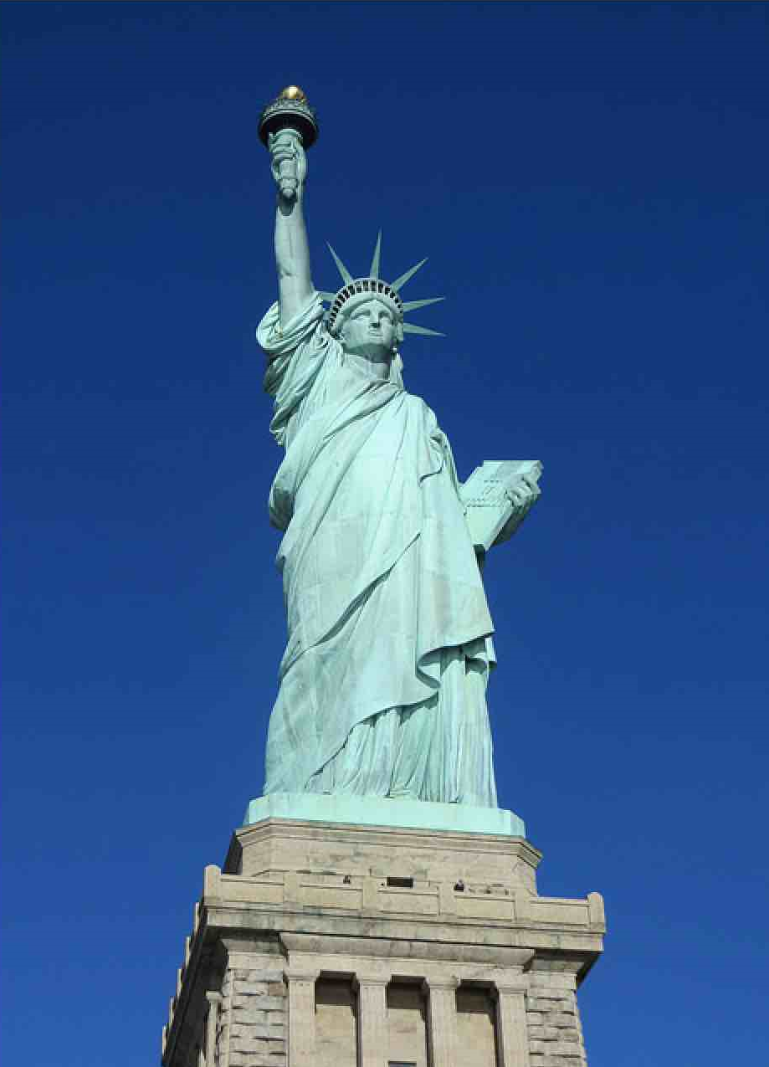
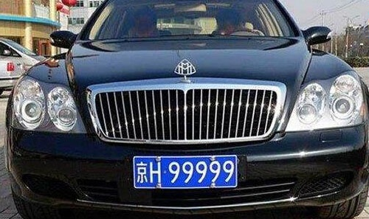

Homework 1
Give two images (liberty.png and car.png) for testing as follow:
1.Read a RGB image and write a function to convert the image to grayscale image.
2.Write a convolution operation with edge detection kernel
and activation function (ReLU: rectified linear unit)
3. Write a pooling operation with using Max pooling, 2x2 filter, and stride 2
4. Write a binarization operation (threshold = 128). (>=128) set 255 (<128) set 0
C/C++ and Python are allowed to use (Choose one to finish homework)
Note: Output Q1 -> Input Q2-> Input Q3 -> Input Q4

Slide 5
OpenCV
Open Source Computer Vision Library
It has C++, Python, Java and MATLAB interfaces and supports Windows, Linux, Android and Mac OS
With C++ : https://opencv.org/releases/ (download)
How to install :
https://docs.opencv.org/master/df/d65/tutorial_table_of_content_introduction.html
With Python : pip install opencv-python

Slide 6
Example for the rules in using Opencv Lib
Allow use Opencv for C/C++
Read, load, save, show : cvLoadImage, cvShowImage …
Define size of image: cvSize, cvGetSize
Define image : IplImage or Mat
Not Allow use
Cannot use the function of Opencv Lib to do the main part of homework.
Example:
cvtColor(image, gray, CV_RGB2GRAY); // convert RGB to Gray

Slide 7
OpenCV
Import Library:
import numpy as np
import cv2
Read a image:
img = cv2.imread('image.jpg’)
Check image size:
Height, width, channels = img.shape

Slide 8
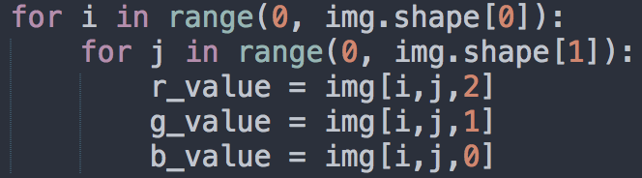
OpenCV
Example for get each pixel value:
Create new mat:
rgb_mat = np.zeros((height,width,3), np.uint8)
gray_mat = np.zeros((height, width, 1), np.uint8)

Slide 9
OpenCV
Show image:
cv2.namedWindow('My Image', cv2.WINDOW_NORMAL)
cv2.imshow('My Image', img)
cv2.waitKey(0)
cv2.destroyAllWindows()
Write image:
cv2.imwrite('output.jpg', img)

Slide 10

Convolution Operation
To produce a feature map

Slide 11


Convolution Operation

Slide 12
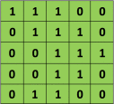
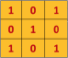

Convolution Operation
5 x 5 image
3 x 3 kernel
Notes:
https://towardsdatascience.com/applied-deep-learning-part-4-convolutional-neural-networks-584bc134c1e2

Slide 13
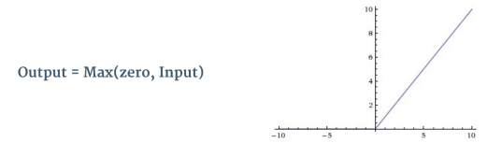

Activation function
ReLU operation (rectified linear unit )
An additional operation called ReLU has been used after every Convolution operation

Slide 14
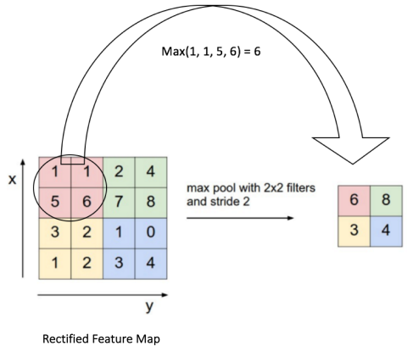
pooling operations
Pooling Step: Spatial Pooling (also called subsampling or downsampling) reduces the dimensionality of each feature map but retains the most important information.
Spatial Pooling can be of different types: Max, Average, Sum etc.

Slide 15
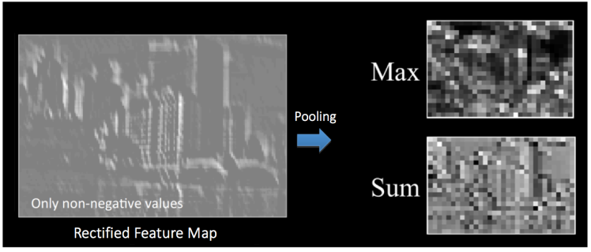
Pooling operations
Pooling Step

Slide 16
Homework 01
Grade
Program (80%)
Q1: 15%
Q2: 25%
Q3: 25%
Q4: 15%
Report : 20% (English)
Explain your program and method
Result images
(2 input images, 8 outputs images)

Slide 17
Homework 01
Require for program
You just create an empty project and write your homework on the one program ( using class or subprogram, …) for C/C++
name.py for python
Write your report by English (PDF)
Explain how your main function working and show the results on your report.

Slide 18
Homework 01
Please compress your files (program and report)
StudentID_hw1
Please send your homework to me by email.
Remember to tell me who you are. qqwweerr987@gmail.com
Deadline: 2022/10/17 23:59
For each hour late, 10% of the total possible points will be deducted.
Don’t share your code with other students.

Slide 19
Thanks for your attention

